Slide 1
U of T VoIP Project Updates – May 2018
StevEN Wall
Will Hu
Notes:
Welcome everyone to our session about the progress of the VoIP migrtion at UofT. Thank you for attending Techknowfile. We are really excited about the VoIP project and happy to share some information updates on the progress as we heading into our second year of the project. We are just going to take a few minutes to talk about VoIP and if you have any questions feel free to ask. We will also have a Q & A at the end of our presentation

Slide 2
Discussion Topics
Updates on the ITS VoIP Project
Overview of the Migration Process
Network Considerations
Some Useful VoIP Features
Other Telephony Enhancement Projects
Q & A
Notes:
These are the topics we are going to cover today

Slide 3
Meet the VoIP Project Team / ITS,Telecommunications
Tony Danas – Manager, Telecommunications
Steven Wall – Project Communication Coordinator
Dave Tseu – Unified Communication Support Analyst
Will Hu – Unified Communication Support Analyst
David Flaherty – Unified Communication Support Analyst
Joanne Barteski – Telecommunications Consultant
Mary Kesic – Telecommunications Consultant
Notes:
Meet the telecom team,
Joanne and Mary are not directly involved in the project but they do work for the project, they are our contact to Bell retail.

Slide 4
Migration Progression Chart
Notes:
We started off with almost 14,000 lines in the University. Over the last year we have been streamlining the process and we forecast to hit the 2000 milestone of VoIP lines this month.
As you can see we still have a lot of work to do.

Slide 5
Departments Fully Migrated
Faculty of Architecture
Faculty of Dentistry
Faculty of Nursing
Faculty of Social Works
Enrolment Services
ITS, Central IT
SciNet
Internal Audits
Rotman Commerce
School of Graduate Studies
Faculty of Arts & Science
Dept. of Finance
Dept. of Advancement
Dept. of History
Faculty of Medicine
Departments within MaRS Building
UTM
I&ITS Service Desk
Office of the Registrar
New North B Building
Notes:
or close to completed. One of the first full departments we migrated was Fac of Architecture. They were moving to a new building that only supported VoIP so we were able to migrate the entire Dept.
Dentistry: running an internal PBX system that came to the end of its lifetime needed a new solution urgently cause the system was crashing frequently. We set them up with the full package–not only did we migrate all their lines we also set up a call centre, an overhead intercom system, student voicemail accounts.
Date of porting,, PBX died.
Enrolement services – run a v.large call centre. their existing call centre solution was coming up for renewal and they needed another solution that provided more features like details statistics on thier calls. We used this opportunity to show them the VoIP features and moved the entire department over
We also deployed VoIP onto the campus at UTM
North building B brand new building, No option for landline so first full dept to go with VoIP.
Fac of A&S these 3 are first full dept to move, working with the IT team as A&S has planned to move all dept and this is the largest Department.

Slide 6
Departments In the Process of Migration
Faculty of Arts & Science
Information & Instructional Technology
Dept. of Ecology & Evolutionary Biology
Dept. of Cell & Systems Biology
Dept. of Psychology
Dept. of Computer Science
Dept. of Mathematics
Office of the Faculty Registrar
Innis College
Woodsworth College
University College
Women & Gender Studies
Faculty of Applied Science & Engineering
Faculty of Information
Faculty of Kinesiology
Faculty of Law
Faculty of Music
HR & Equity
Ancillary Services
Facilities and Services
University Planning, Design and Construction
Munk School of Global Affairs
OISE
Rotman School of Management
Student Life
Simcoe Hall – VP Divisions / Portfolios
U of T Schools
School of Continue Studies
University Advancement (DUA)
Notes:
List of departments currently in progress. Most depts have decided to go with a phase approach, its up to the department whether they want to do phases or all at once.
some designate a pilot group as a test, get used to the services before the rest of the department moves
Faculty of Applied Science & Engineering (new building coming online this year will be all VoIP lines)

Slide 7
Departments In Planning / Network Upgrade Stage
Dalla Lana School of Public Health
Institute of Health Policy, Management and Evaluation
Robarts Library
Faculty of Pharmacy
Faculty of Medicine
Hart House
Faculty of Arts & Science - Dept. of Chemistry
Notes:
These depts are beginning the process of moving to voip, we are still in the stages of internal planning or in the process of upgrading their network infrastructure. Cable upgrades/switch upgrades.

Slide 8
Top 7 U of T Units with the Most Centrex Lines
Department | Number of Centrex Lines
Faculty of Arts & Science | 2000+
Faculty of Medicine | 1000+
Rotman School of Management | 600+
OISE | 500+
Facilities & Services | 500+
Robarts Library | 400+
Division of University Advancement (DUA) | 275
Rotman migrated first pilot group on April 16th
OISE will begin migrating the first two groups in May
F&S will begin phase 1 migration in May
DUA is targeting phase 1 migration in May
Notes:
These are some interesting stats;
We are currently working with all of these departments to move to Voip
All have begun except medicine as they are still in the process of migrating to outlook 365 and will begin migrating to VoIP in the fall.

Slide 9
Centrex to VoIP Migration Process
Step 1: Initial Line Discovery
Department submits a request for migration via web submission, Telecom setup meeting with the department to further discuss the migration plan
Step 2: Network Assessment
Telecom assess the department network and provides recommendation on switch upgrade (if necessary)
Step 3: Implementation
Submit Centrex Port Request
Perform VoIP simulation test
Install softphone client, setup headsets/phones
Telecom provides a list of the Centrex lines that belongs to the department to review
Test VoIP phone on site
Submit VoIP Order Form
User Training
Wait for port date
Configure switches for Voice VLAN

Slide 10
Some Network Considerations for VoIP
Power Over Ethernet Switch
Link Layer Discovery Protocol-Media Endpoint Discovery (LLDP-MED)
DHCP Requirement, Dynamic & Static
Implementing Voice VLAN
Office With Only One Single Network Jack But With Multiple Devices
Backup Power Supply in Network Closets
Notes:
ability to carry configuration instructions from the
switch to the VoIP phone, eg VLAN ID or QoS marker
Advantages of Having a Separate Voice VLAN
1) Reduces impact of broadcasts/multicasts on a large data VLAN hitting the voice phones.
2) Allows the voice VLAN to be firewalled off to prevent DoS/Virus attacks therefore increase security.
3) As already indicated, allows separate DHCP services. The VoIP VLAN provided by ITS uses a separate DHCP server and only assign DHCP IPs for specific MAC prefixes (Polycom in our case).
4) Separate VLANs can assist administrator better when troubleshooting is required.

Slide 11
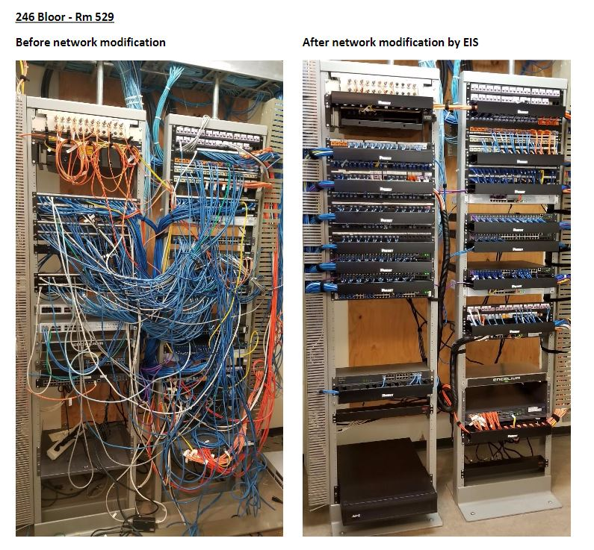

Slide 12
VoIP Feature Highlights
ACD / Hunt Group (Included in the Standard License)
Call Centre
Hoteling
Pull Call
Define your own call routing rules!
Intercom Paging
Notes:
call forwarding aways/busy/no answer
simultaneous rings
greeting message for different condition, vacation message, busy, no answer.
VM to email feature, transcribe feature

Slide 13
Enhancements of Telephony Services Projects
SAP Integration
Campus Emergency Dashboard
BROADCONNECT USER MANAGEMENT PORTAL
Notes:
Reset VM password, VoIP credential
Change address info
Change certain phone settings, as well as VM settings
Check your call history

Slide 14
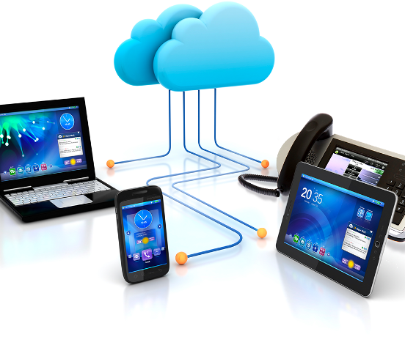
Q & A
Visit us online
http://telecommunications.utoronto.ca
or contact us at
416-978-VOIP (8647)
voipservices@utoronto.ca

Slide 15
Add a Slide Title - 4

